Slide 1

UBC Ovarian Cancer Subtype Classification and Outlier Detection (UBC-OCEAN)
Students: Ryabykin Alexey, Osokin Mikhail, Rudenkov Dmitry
Master’s Program: Data Science
HSE 2023
1

Slide 2
Agenda
Task description
Models
Exploratory Data Analysis
Color deconvolution
CLAHE
Adaptive Sharpness Aware Minimization
Results
HSE 2023
2

Slide 3
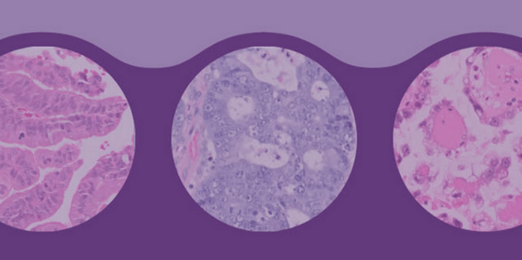
Task description
Ovarian carcinoma is the most lethal cancer of the female reproductive system. There are five common subtypes of ovarian cancer: high-grade serous carcinoma, clear-cell ovarian carcinoma, endometrioid, low-grade serous, and mucinous carcinoma.
The goal of the UBC Ovarian Cancer subtypE clAssification and outlier detectioN (UBC-OCEAN) competition is to classify ovarian cancer subtypes. We will build a model trained on the world's most extensive ovarian cancer dataset of histopathology images.
There are two categories of images: whole slide images (WSI) and tissue microarray (TMA). Whole slide images are at 20x magnification and can be quite large. The TMAs are smaller (roughly 4,000x4,000 pixels) but at 40x magnification.
HSE 2023
3

Slide 4
Models
We implemented different models:
Resnet50
Efficientnet_v2
Сoatnet
Another transformer model
And approaches to training:
one_vs_all (not effective)
use cross-entropy with weights for classes inversely proportional to class frequencies
ADAM
etc.
HSE 2023
3
Notes:
CoatNET384, CoatNET224, EfficientNet_v2

Slide 5
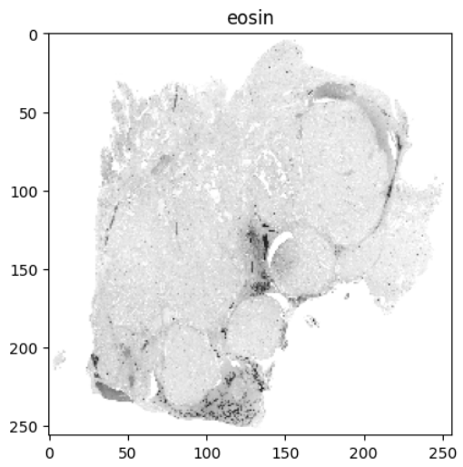
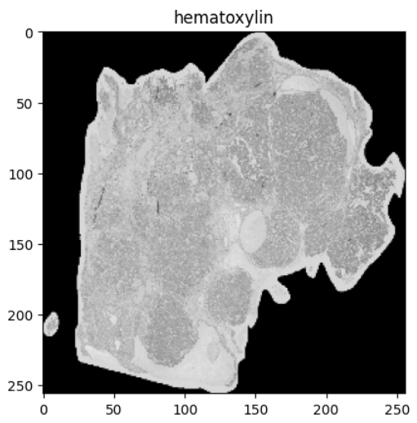
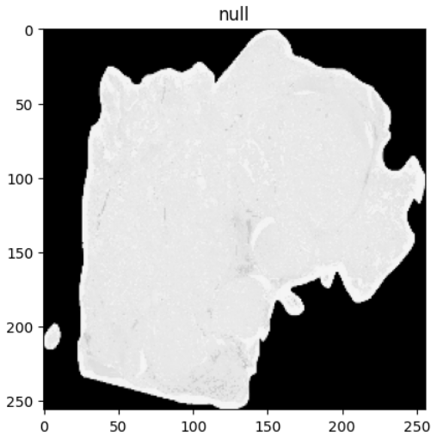
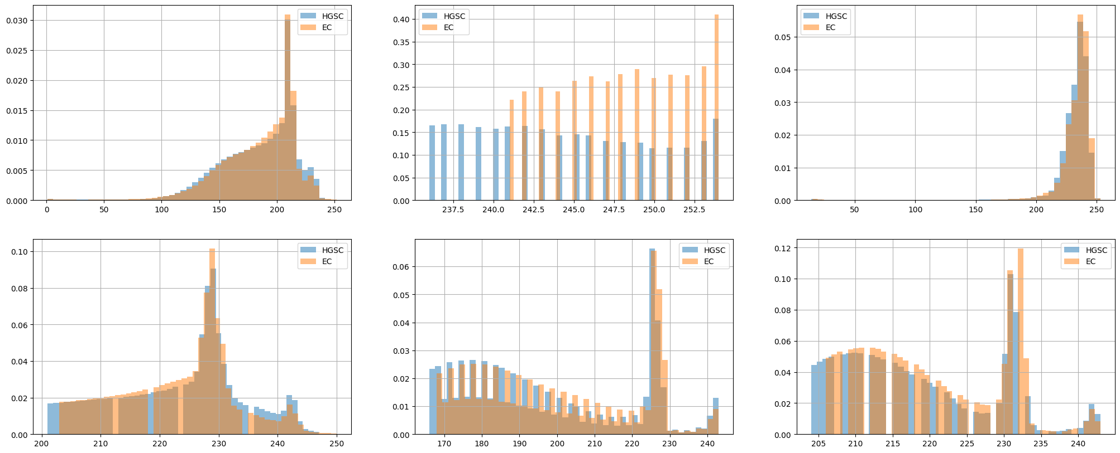
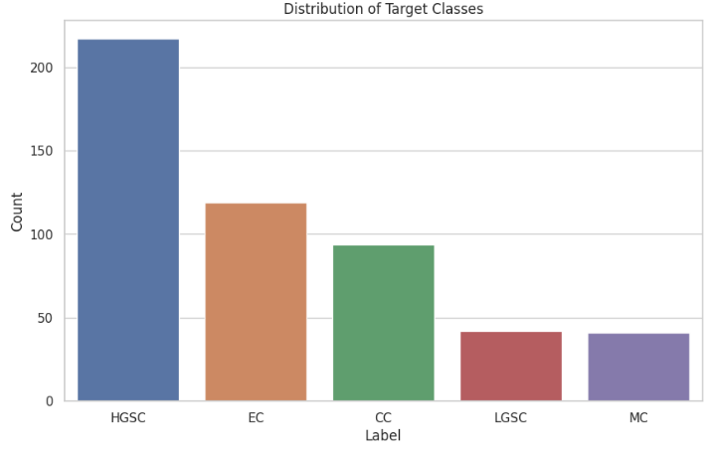
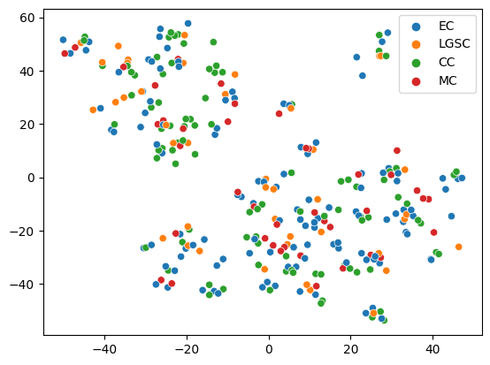
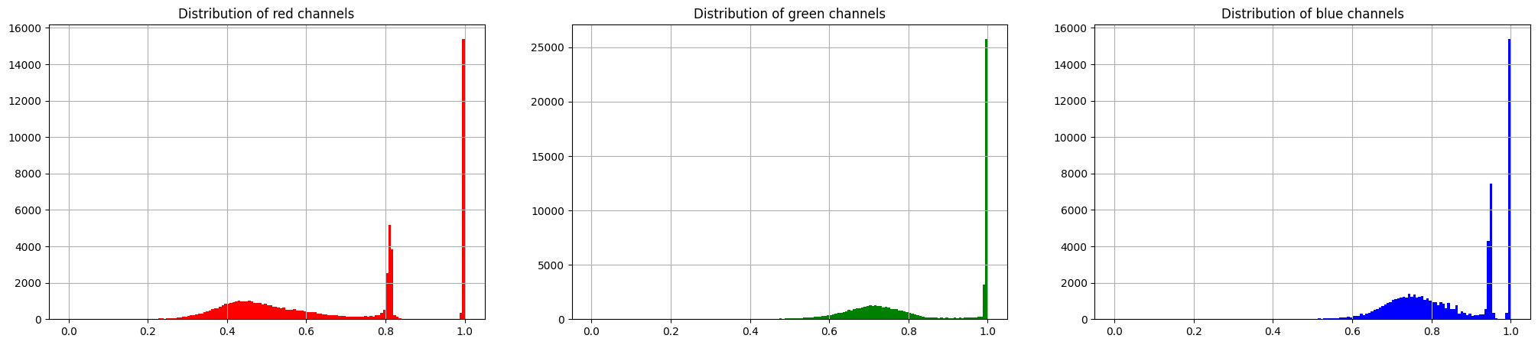
Exploratory Data Analysis
Class distributions
Color and staining methods
Histogram distributions of staining filters and colors
Embedding representation
HSE 2023
4

Slide 6
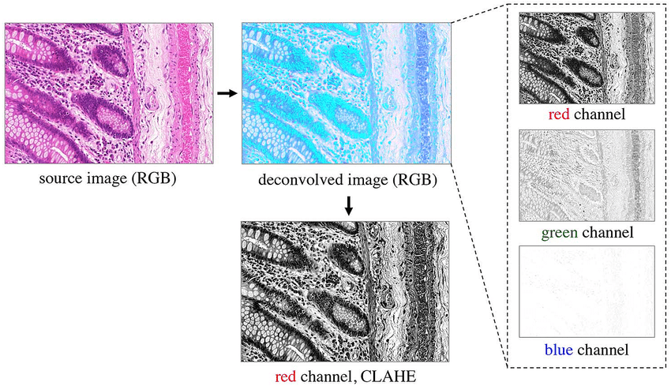
Color deconvolution
Color deconvolution is a technique used in image processing to separate an image into its constituent color channels, particularly in the context of microscopy and digital pathology. The primary goal is to isolate and enhance specific stains or colors within the image for better analysis and visualization.
HSE 2023
5

Slide 7
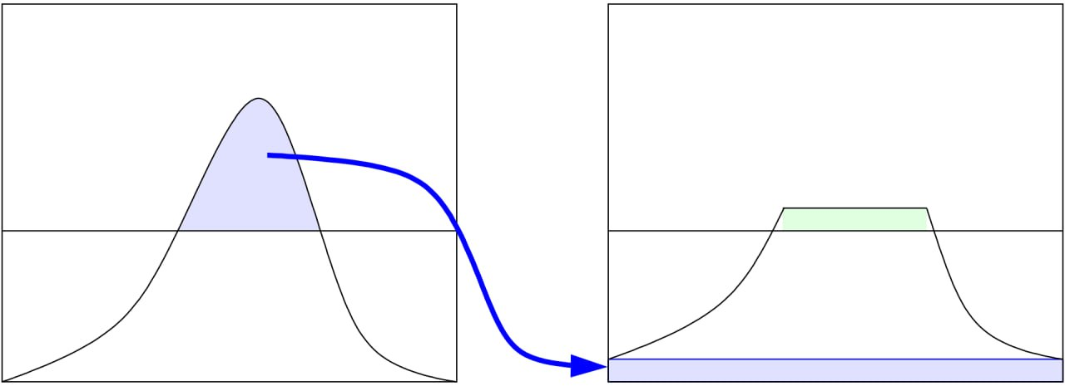
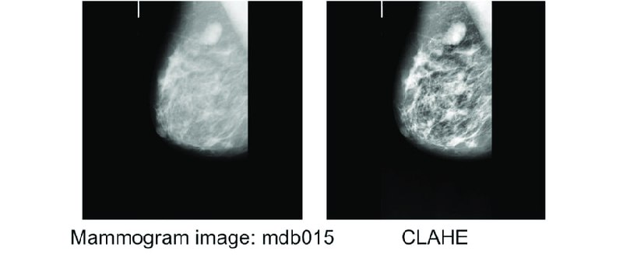
Contrast-Limited Adaptive Histogram Equalization (CLAHE)
Contrast Limited AHE (CLAHE) is a variant of adaptive histogram equalization in which the contrast amplification is limited, so as to reduce this problem of noise amplification.
HSE 2023
5

Slide 8
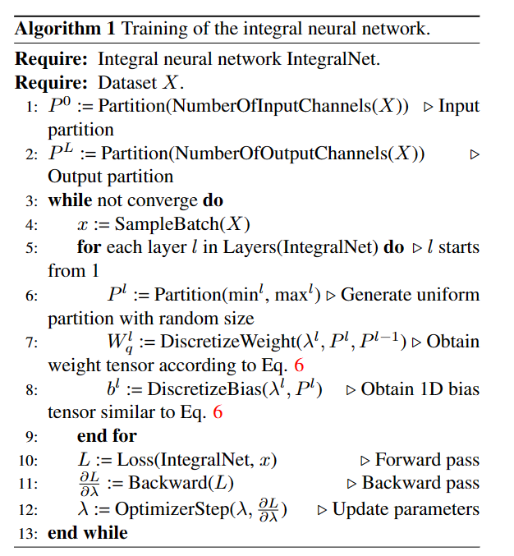


Results
Transformer model little version
EfficientNet: with popularity
EfficientNet: weighted value of predictions by min_max Scaler(metrics) for validation
HSE 2023
8

Slide 9
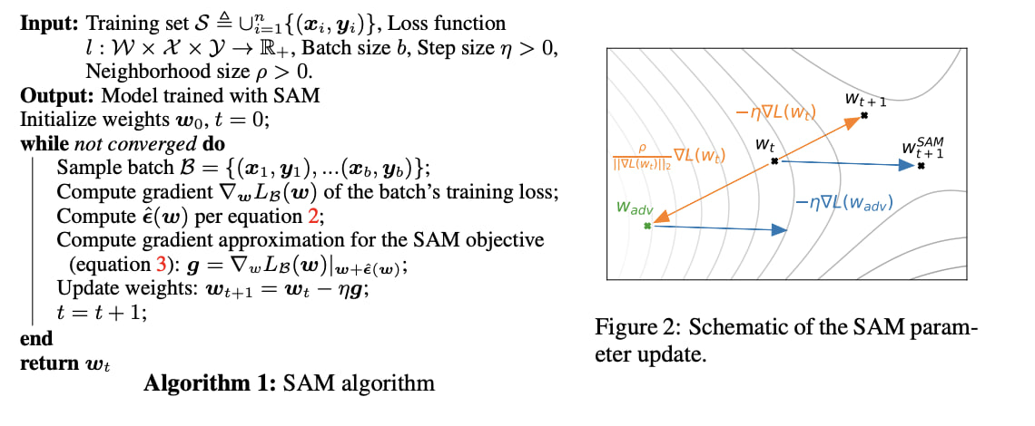
Adaptive Sharpness Aware Minimization
Sharpness-Aware Minimization, or SAM, is a procedure that improves model generalization by simultaneously minimizing loss value and loss sharpness. SAM functions by seeking parameters that lie in neighborhoods having uniformly low loss value (rather than parameters that only themselves have low loss value).
HSE 2023
7

Slide 10
Thank you for your attention
HSE 2023
1

